Slide 1
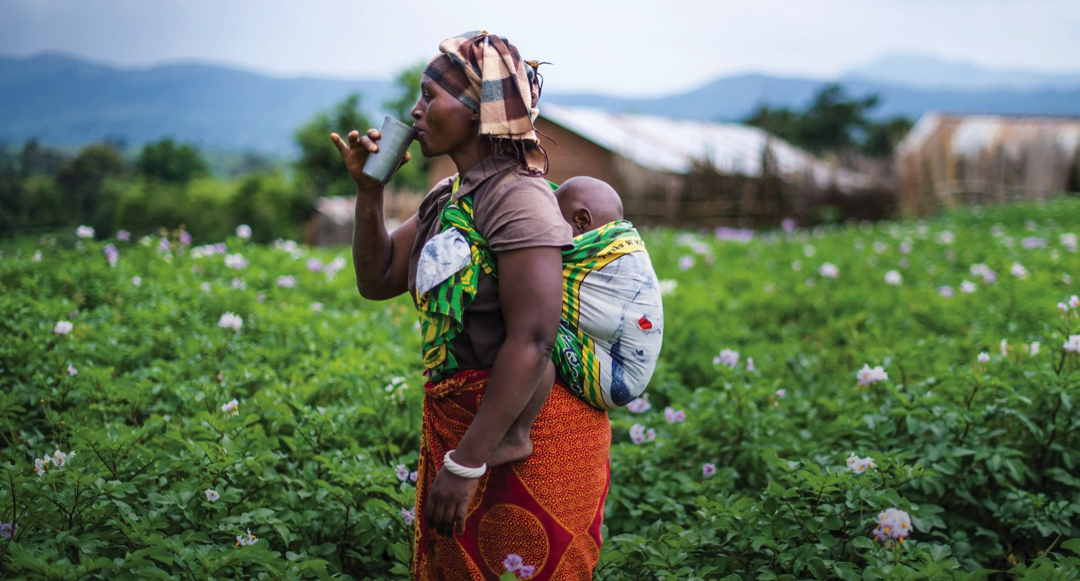

Slide 2
2.2 BILLION PEOPLE
lack access to safe water every day

Slide 3
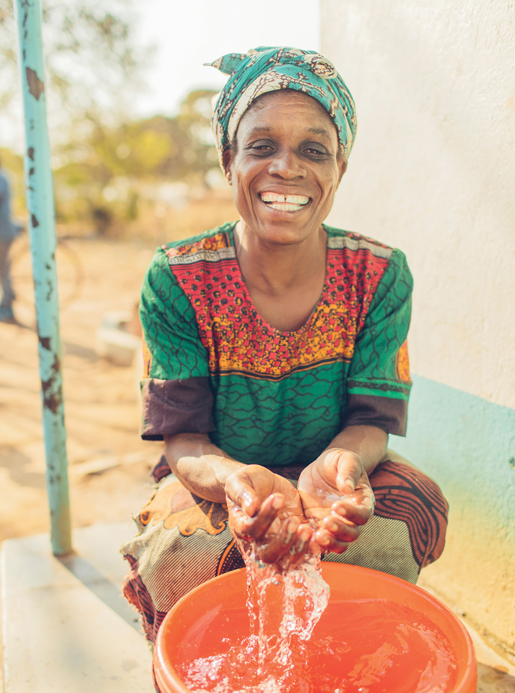
ADVINTAGE DISTRIBUTING IMPACT
On behalf of everyone at Water Mission and the millions around the world that now have access to safe water….THANK YOU!

Slide 4
water builds
hope

Slide 5
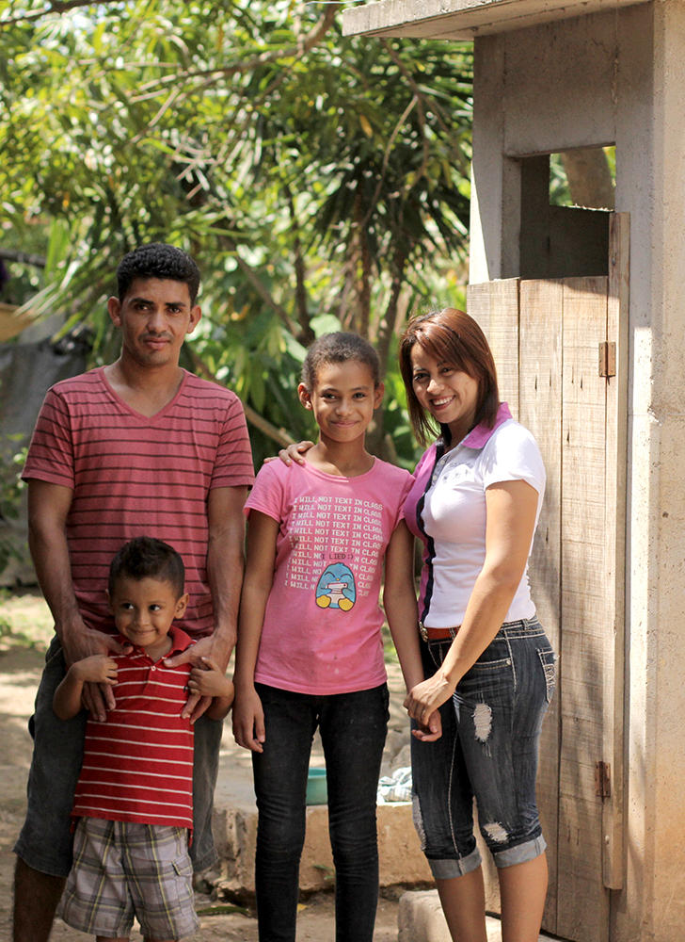
Honduras
Los Olivos
1,615 people with access to safe water.
El Pelon
800 people with access to safe water.
Carrizalito
1,000 people with access to safe water.

Slide 6
Honduras Map
Los Olivos
El Pelon
Carrizalito

Slide 7
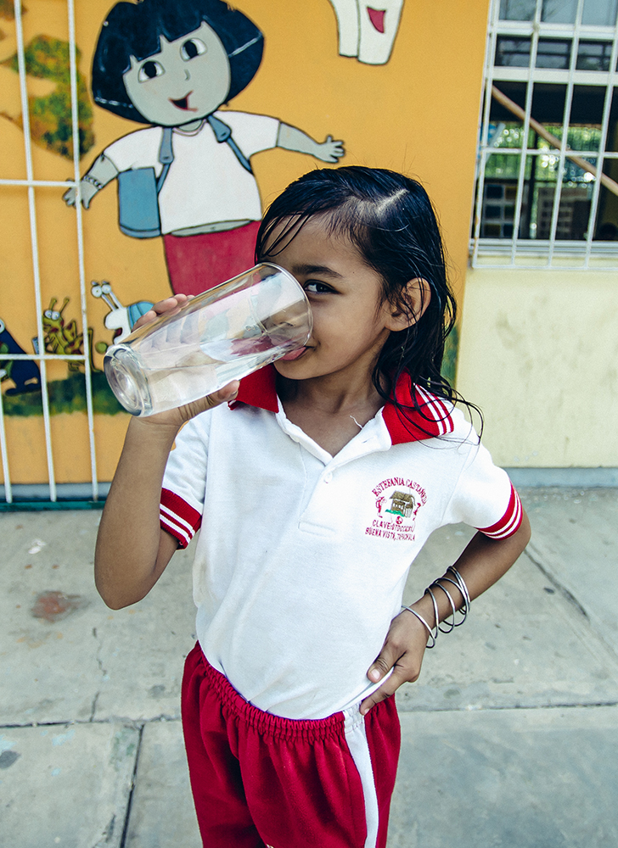
Mexico
Lacanja
2,050 people with access to safe water.
Franciso Madero
1,490 people with access to safe water.

Slide 8
Mexico Map
Lacanja
Francisco Madero

Slide 9
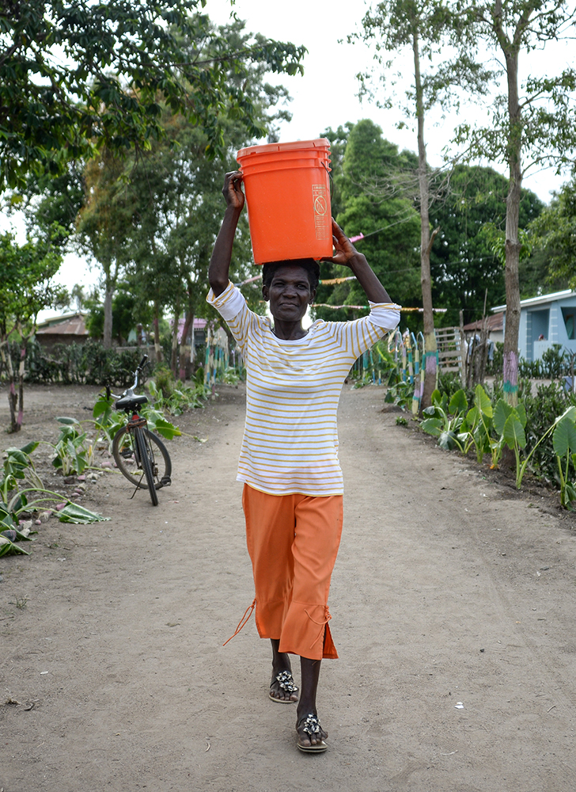
Haiti
Capity
2,500 people with access to safe water.
Liancourt
2,400 people with access to safe water.
Dauphine
3,000 people with access to safe water.

Slide 10
Haiti Map
Capity
Dauphine
Liancourt

Slide 11
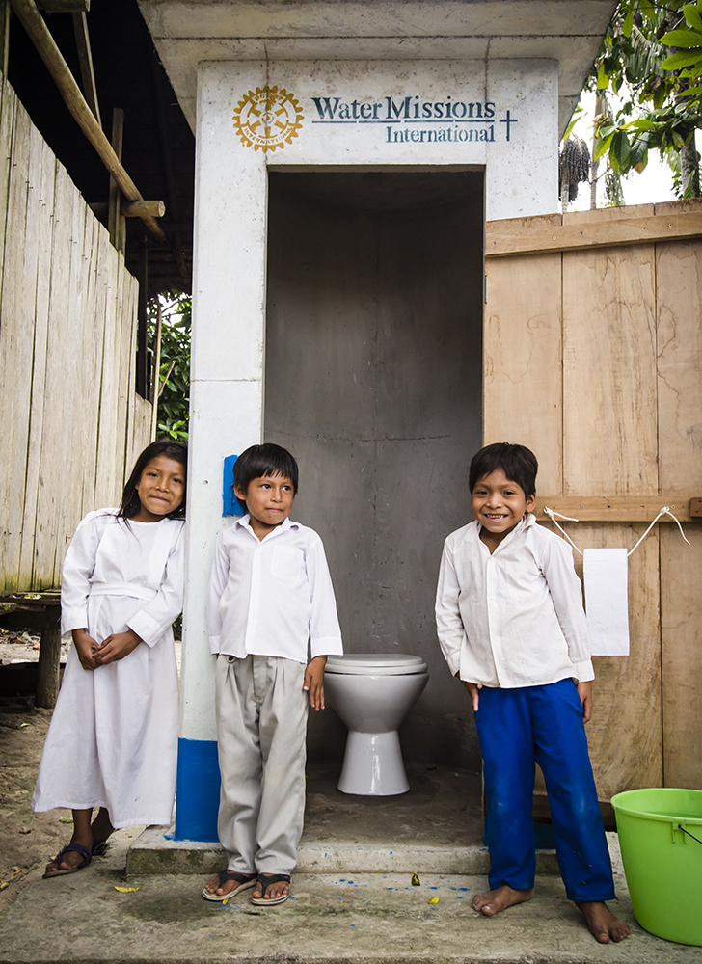
Peru
Picuro Yacu
1,000 people with access to safe water.

Slide 12
Peru Map
Picuro Yacu

Slide 13
Tanzania
Msamalo
4,085 people with access to safe water.
Ikombo
4,172 people with access to safe water.

Slide 14
Tanzania Map
Ikombo
Msamalo

Slide 15
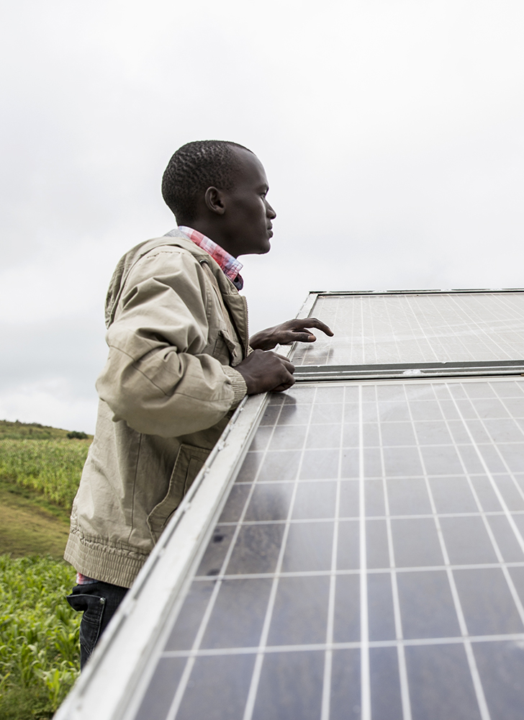
Kenya
Ptulungwo
2,400 people with access to safe water.
Mavindini
3,080 people with access to safe water.
Kinyongo
4,000 people with access to safe water.
Mbembani
1,500 people with access to safe water

Slide 16
Kenya Map
Ptulungo
Mbembani
Kinyongo
Mavindini

Slide 17
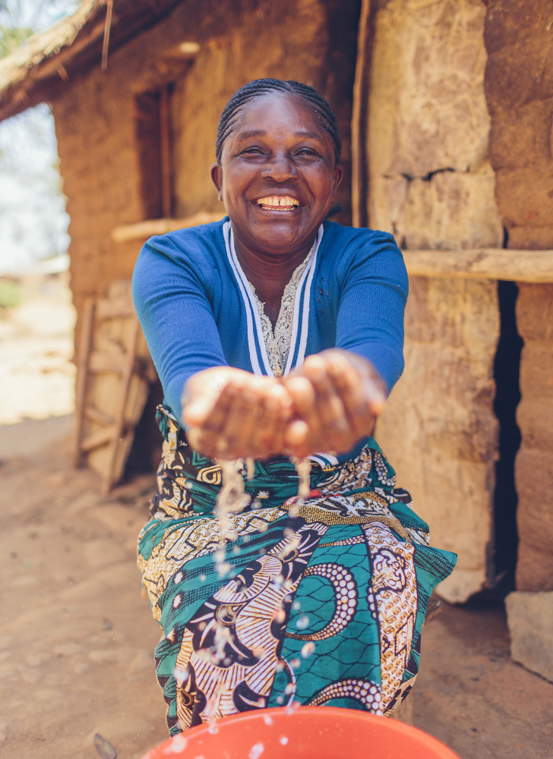
Malawi
Mphomwa Trading Center
5,300 people with access to safe water.
Suza
3,233 people with access to safe water.

Slide 18
Malawi Map
Mphomwa
Suza

Slide 19
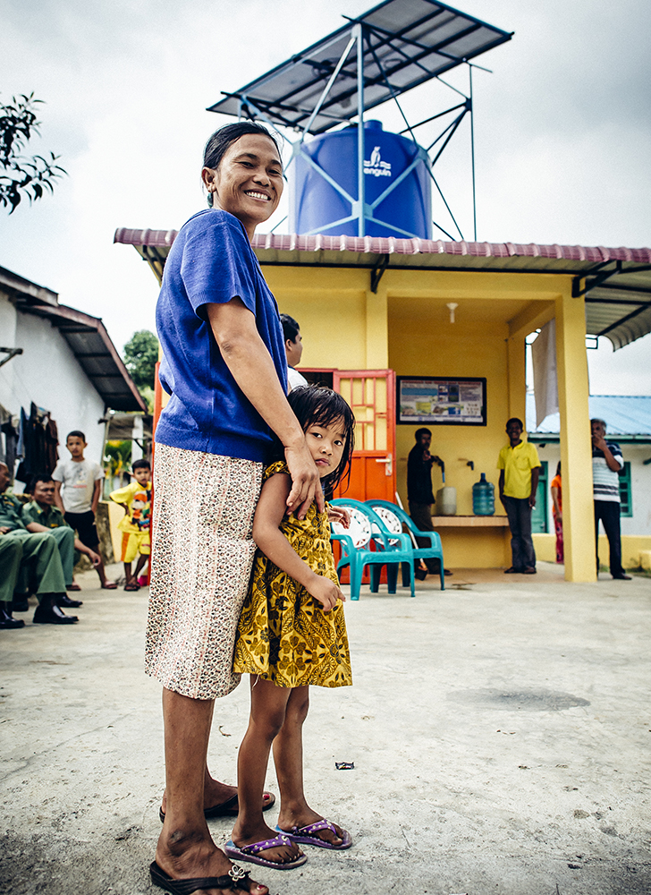
Indonesia
Langaleso
720 people with access to safe water.
Pulu
1,476 people with access to safe water.
Salubomba
1,440 people with access to safe water.

Slide 20
Indonesia Map
Langaleso
Pulu
Salubomba

Slide 21
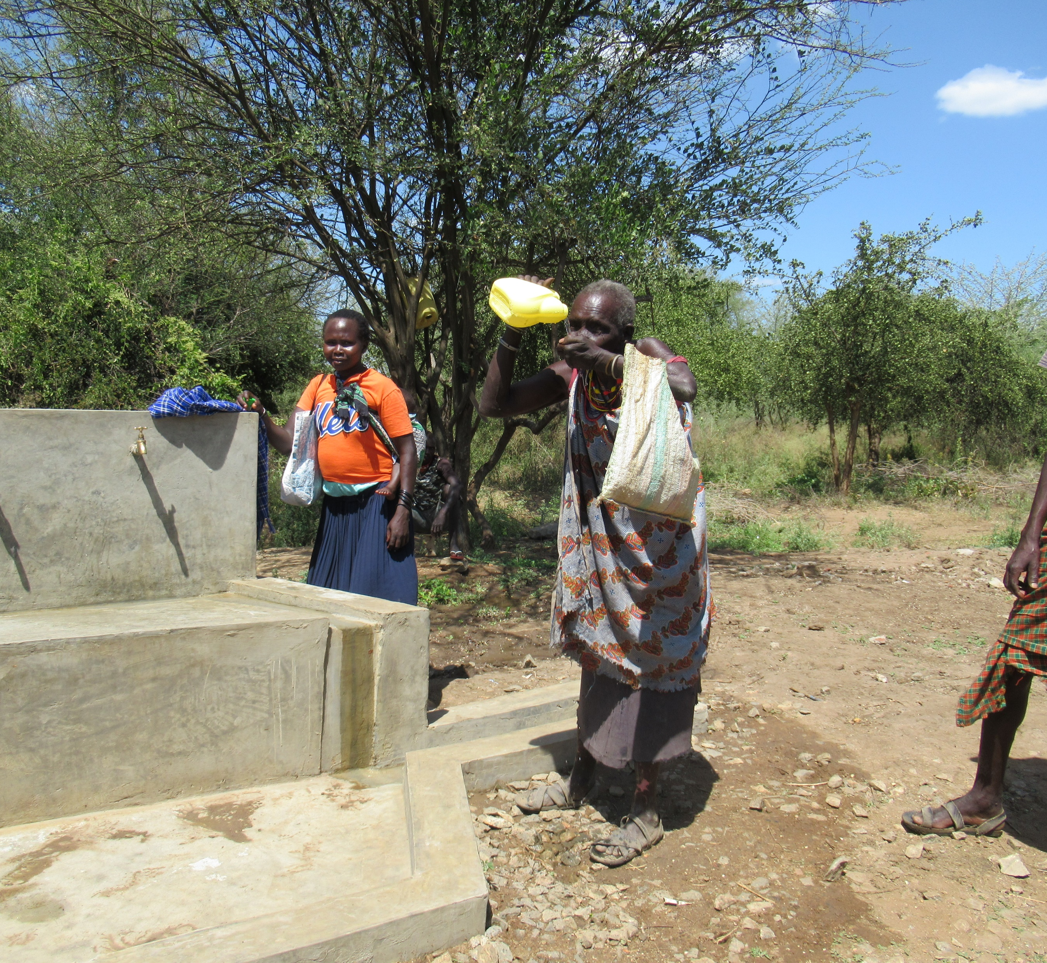
Ptulungo, Kenya
Quotes form community members before:
“My wife and daughters go 2 kilometers each day to look for water. We lose time we need to use for cultivating and farming. My family gets very tired.” – Richard Kingor, local farmer and father of 4
Quotes from community members after:
“Water related stress has left our family.”
“Our health is improving now that the water is safe.”
“Our market is going to expand due to availability of water.”
“Students will not waste time for studying in search of water.”

Slide 22
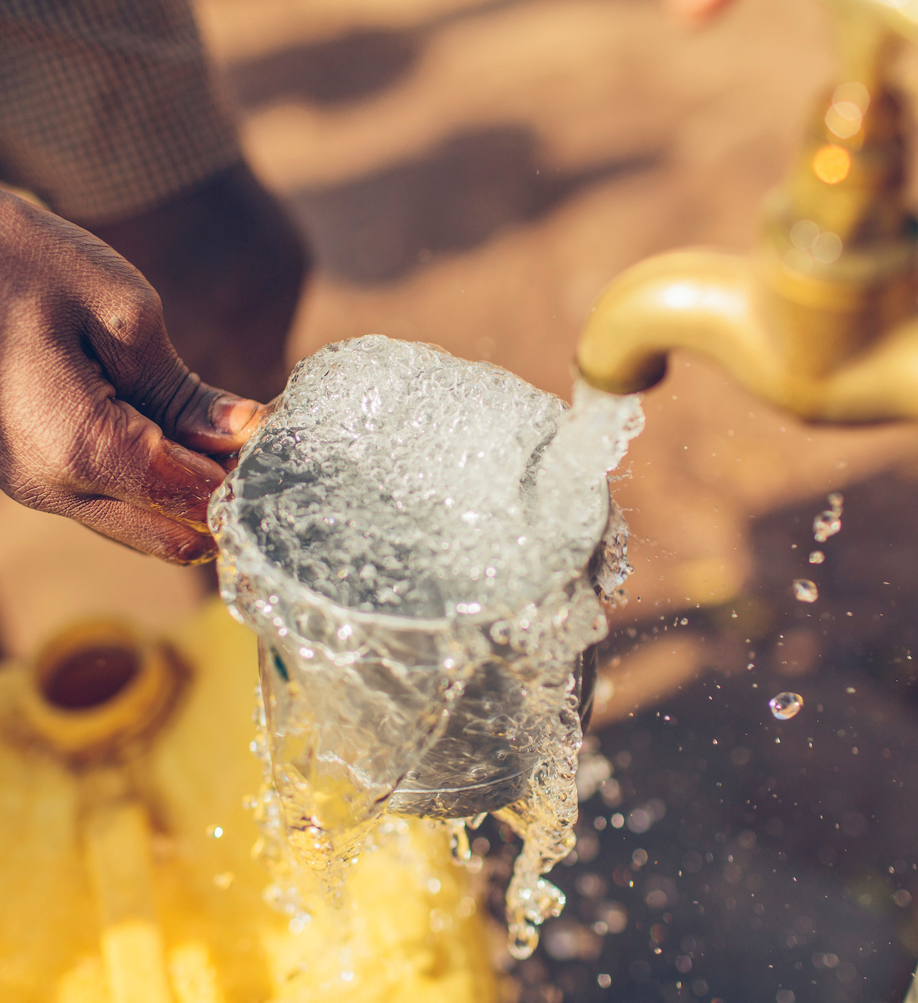
In 2020 Advintage Distributing provided 47,261 people with access to safe water!

